Slide 1



RD-WASH MANAGEMENT

Slide 2

RD-WASH Workflow Process
Create WashJobs
Verify Uniform Code
Send for Washing on Schedule
ESD Testing
Receive Washed Uniforms
Return to Stock
1.00*10⁴Ω
-
1.00*10⁹Ω
Repeat Washing
Verify Employee Uniform Code
Proceed to Check System Record
Separate by Department
Contact the supervisor for uniform pickup.

Slide 3
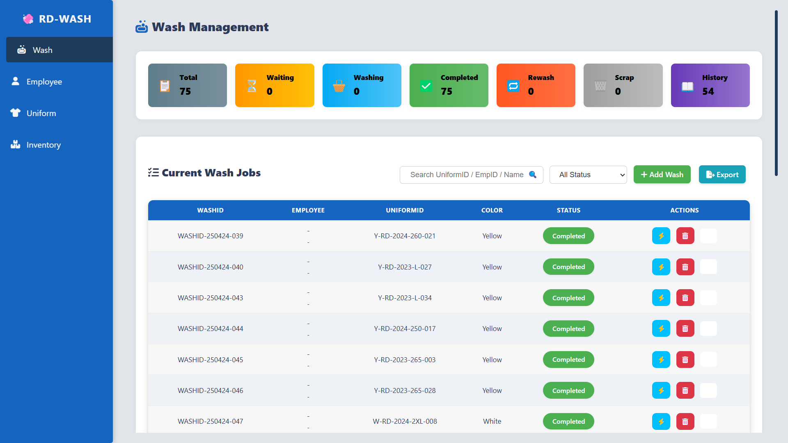
WASH MANAGEMENT

Slide 4
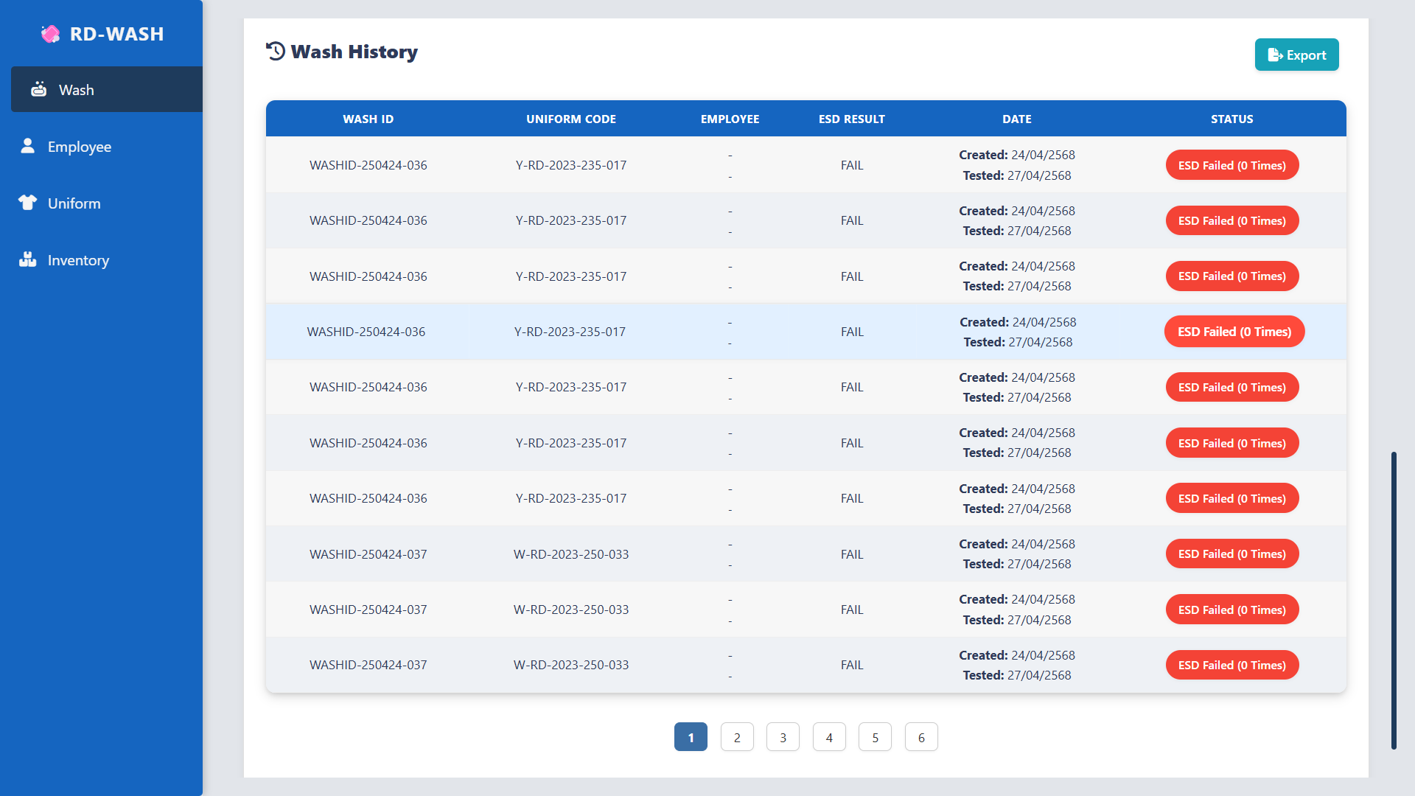
WASH MANAGEMENT

Slide 5
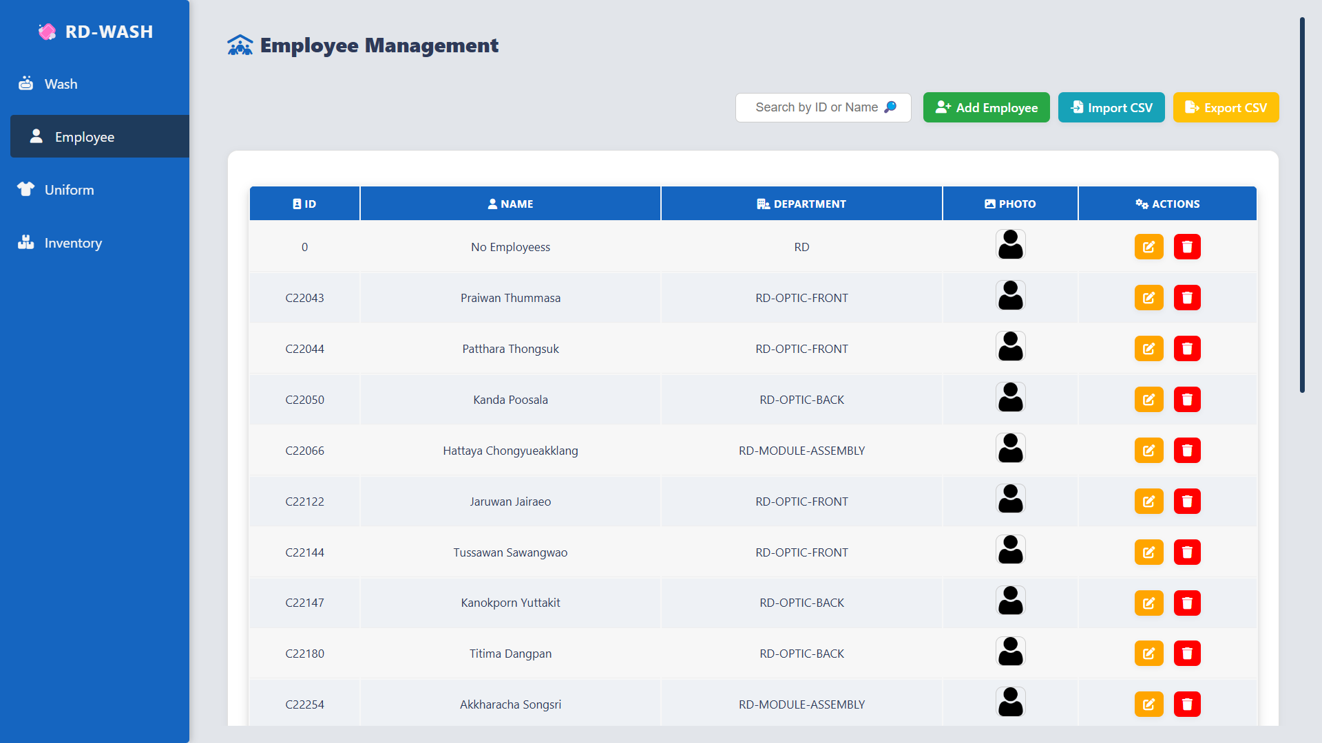
EMPLOYEE MANAGEMENT

Slide 6
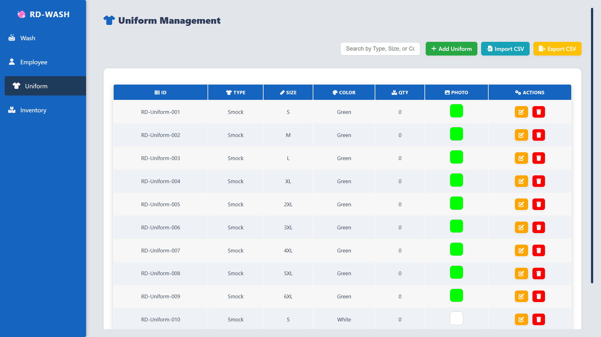
UNIFORM MANAGEMENT

Slide 7
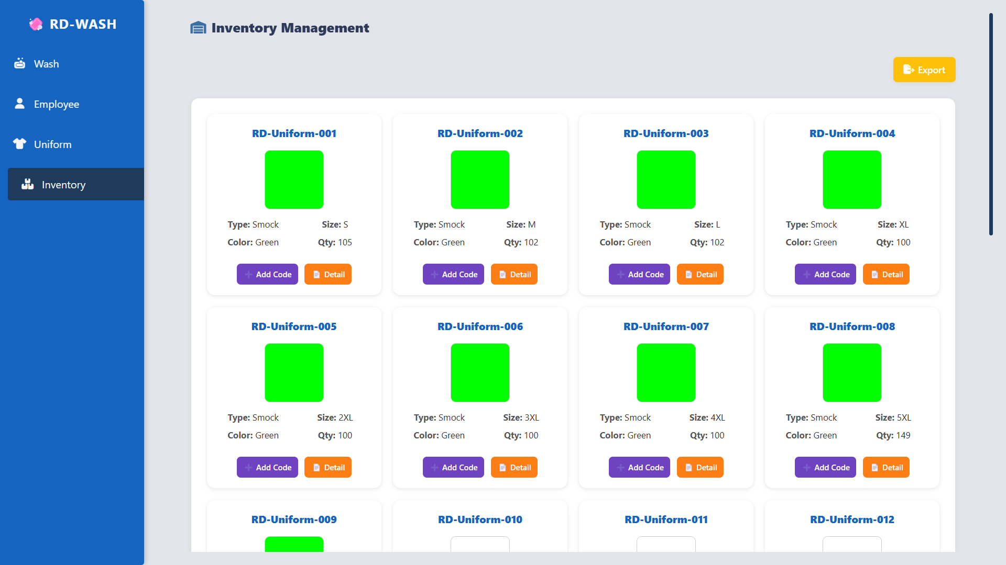
INVENTORY MANAGEMENT
INVENTORY MANAGEMENT

